Slide 1

Problem Solving & Programming
Yunus Teke
CEIT382

Slide 2

Table of Contents
Motivational Video
What is an Algorithm?
Examples of Algorithms
Assesment
Think-pair-share
One minute paper
Closure

Slide 3

Motivational video

Slide 4

What is an Algorithm?
An algorithm is a set of step-by-step instructions designed to accomplish a task.
Algorithms are maden to solve a specific problem.

Slide 5

Example
How can you sort the elements in the following array? Which algorithm would you use?
[16, 9, 92, 1, 5, 25]

Slide 6
Sorting Algorithm Examples
Selection Sort
Bubble Sort
Merge Sort

Slide 7
Bubble Sort
A simple sorting algorithm that repeatedly steps through the list, compares adjacent elements, and swaps them if they are in the wrong order. The process repeats until the list is sorted.

Slide 8
Bubble Sort
First iteration:
[16, 9, 92, 1, 5, 25]
[9, 16, 92, 1, 5, 25]
[9, 16, 1, 92, 5, 25]
[9, 16, 1, 5, 92, 25]
[9, 16, 1, 5, 25, 92]
Second iteration:
[9, 16, 1, 5, 25, 92]
[9, 1, 16, 5, 25, 92]
[9, 1, 5, 16, 25, 92]
Third iteration:
[9, 1, 5, 16, 25, 92]
[1, 9, 5, 16, 25, 92]
[1, 5, 9, 16, 25, 92]
Fourth iteration:
[1, 5, 9, 16, 25, 92]
No changes has been made here. List is sorted.

Slide 9
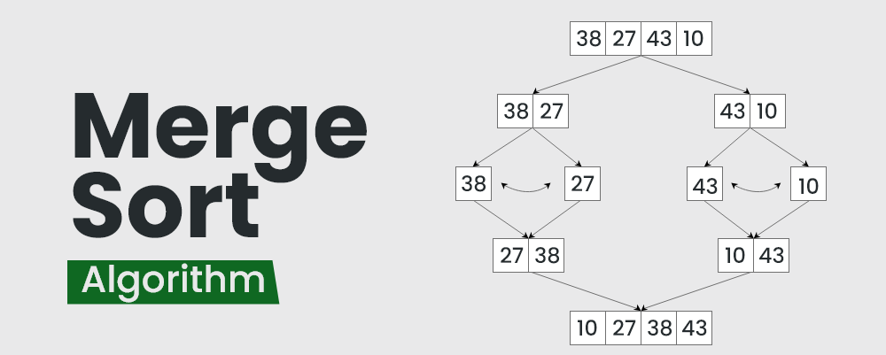
Merge Sort is an algorithm that divides the list into smaller sublists, recursively sorts them, and then merges the sorted sublists to produce the final sorted list.

Slide 10
What I want from you to do is…
Read and study the algorithms that I have given you.
Examine the problem.
Pick an algorithm to solve that problem and explain the reason behind your choice. You can came up with your own algorithm. Write a step by step solution. (You have 10 minutes)
One you and your peer is finished, explain them your solution. (You have 3 minutes)

Slide 11

One minute paper
Write down anything from this presentation that you would like to explore further or learn more about.

Slide 12
Thank you for listening.

